Slide 1
PRESENTATION ON mULTIMEDIA
BY GAURAV GAUTAM & SAUGAT NEUPANE

Slide 2
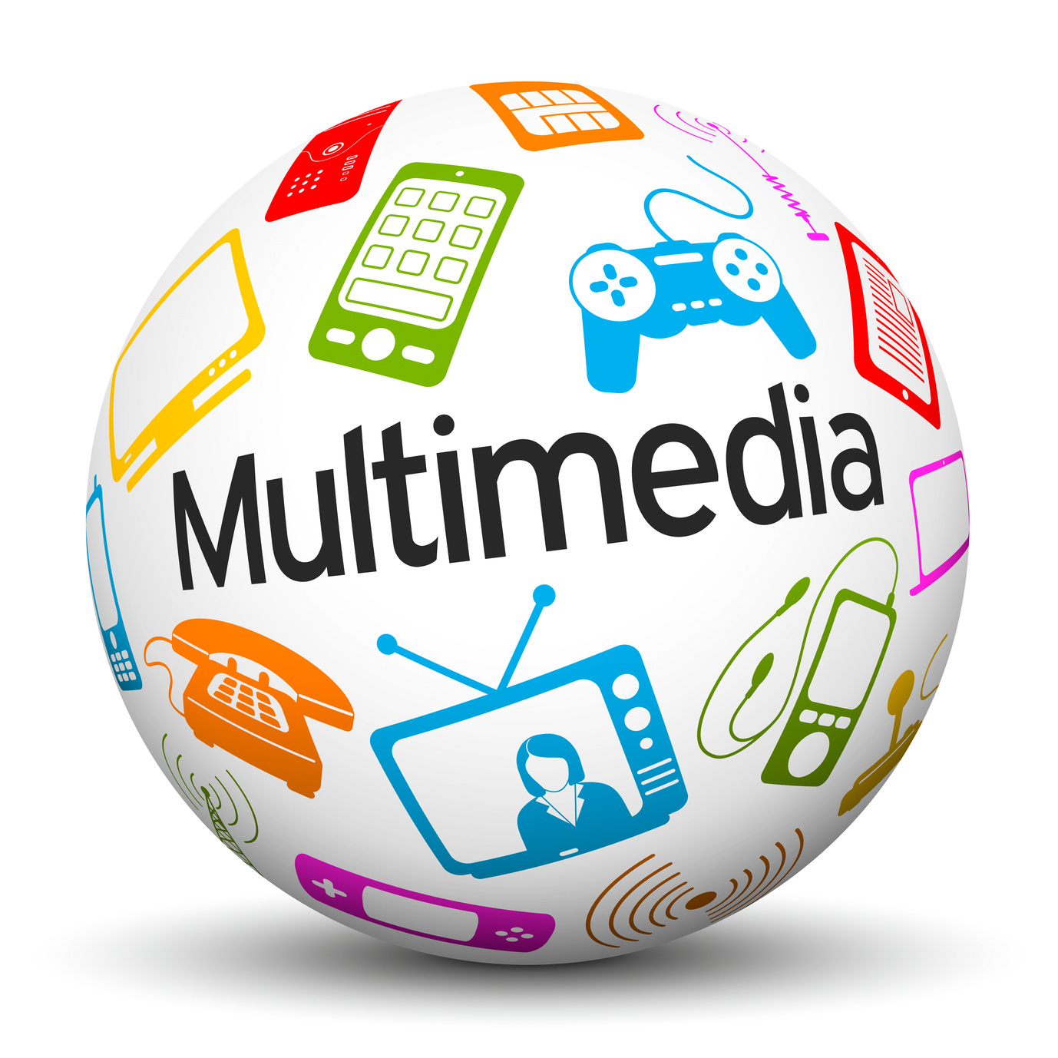
mULTIMEDIA
Introduction
Importance of Multimedia
Element of Multimedia
Characteristics of Multimedia
Applications of Multimedia

Slide 3
Introduction
The term "multimedia" is derived from two words: "multi" meaning many, and "media" meaning the means of communication.
Multimedia describes any application that uses multiple media (graphics, text, animations, audio, and video).
Multimedia is a way of presenting information using a combination of different types of content.
It is widely used in education, entertainment, business, and public information systems.

Slide 4
Importance of Multimedia
Enhanced Communication: Multimedia combines visual, auditory, and interactive elements, making it easier to convey complex ideas.
Engagement: It captures the user’s attention more effectively than plain text or static images.
Versatility: Used in various fields like education (e-learning), entertainment (movies, games), business (presentations), and public information systems (kiosks, websites).
Interactivity: Users can interact with the content, such as clicking on hyperlinks, playing videos, or controlling animations.

Slide 5
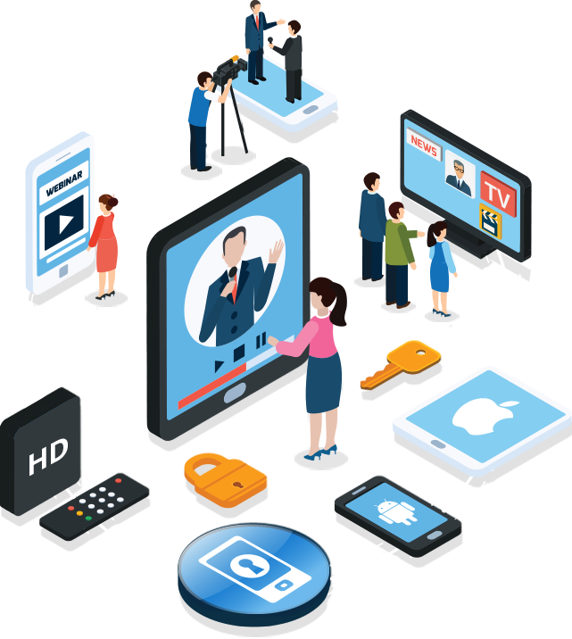
Elements of Multimedia
Text
Graphics
Audio
Video
Animation

Slide 6
1.text
Text in Multimedia is used for titles, menus, navigation, and content.
Text can be animated to move, change, or flash, making it more engaging.
Text effects add visual impact with 2D and 3D effects.
Can be static or dynamic (e.g., scrolling text, hyperlinks).
Example: Text in a PowerPoint presentation or a webpage.

Slide 7
2. Graphics/Images
Image Resolution:
Measured in DPI (dots per inch). Higher resolution means better image quality.
Color Models:
RGB (Red, Green, Blue): Used for digital displays.
HSL (Hue, Saturation, Lightness): Used for color classification.
Types of Animation:
2D Animation – Uses X and Y coordinates (e.g., GIFs, cartoons).
3D Animation – Uses X, Y, and Z coordinates (e.g., Pixar movies, 3D games).

Slide 8
Image Compression:
JPEG: It works well with 24-bit color image. Best for photographs and images with many colors.
GIF: It supports 8 bit of color information (Grayscale, Color map) deal for images with fewer colors (e.g., cartoons, line drawings).
PNG: Improved format over GIF, supports transparency.

Slide 9
3.Audio/Sound
Adds realism, emotions, and engagement to multimedia.
Properties of Sound:
Amplitude: Measures the loudness of sound. Measured in decibels (dB).
Frequency: Measures the pitch of sound. Measured in Hertz (Hz).
Bandwidth: The range of frequencies in a sound signal.
Digital Audio:
Analog sound waves are converted into digital format using an Analog-to-Digital Converter (ADC).
Digital audio is stored in formats like WAV, MP3, and MIDI.

Slide 10
4.Video
Sequence of images (frames) displayed rapidly to create motion.
Allows real-time video transmission over the internet.
Enhances interactivity and visual appeal.
Video is a time-dependent medium, meaning it requires a specific duration to play.
Types of Video:
Live-action videos – Recorded using cameras.
Animated videos – Created using software (e.g., Blender, After Effects).
Common video formats: MP4, AVI, MOV, FLV.

Slide 11
Video Compression:-
Video files are often large, so compression is used to reduce file size without significantly affecting quality. Compression can be lossy (some data is lost) or lossless (no data is lost).
Software or hardware used to compress and decompress video files is called Codecs (Compressor-Decompressor) eg. of codecs:
H.264: Widely used for online streaming (e.g., YouTube, Netflix).
H.265 (HEVC): Provides better compression than H.264, used for 4K videos.
VP9: Developed by Google, used for WebM videos.

Slide 12
5.Animation
Animation is the process of displaying a sequence of still images in rapid succession to create the illusion of motion.
The process of producing animations has four steps:
(1) storyboard layout that sets up the outline of the actions and motion sequence as a simple chain of events,
(2) defining the objects involved, so as to animate each of them,
(3) specifications of key frames that define the actual drawing of the animation scene at a certain point in time, and
(4) generation of intermediate frames that describes the amount of in-between frames between key frames.

Slide 13
Creation of Animation:
Looping:
Playing a short sequence of frames repeatedly.
Example: A rabbit hopping in 2–3 frames, looped to make it appear as if the rabbit is walking.
Morphing:
Transforming one image into another smoothly.
Requires two images: the starting shape and the ending shape.
Example: A person’s face changing into an animal’s face.
Rendering:
The process of generating images from a 3D model or scene.
A 3D animation requires about 30 frames per second for smooth motion.
Example: Rendering a 3D character in a video game.

Slide 14
Thank you !!

